Slide 1
Time series pattern
1. Markov Model
2. Hidden Markov Model
3. Data Mining
4. SARIMA
5. Neural Network

Slide 2
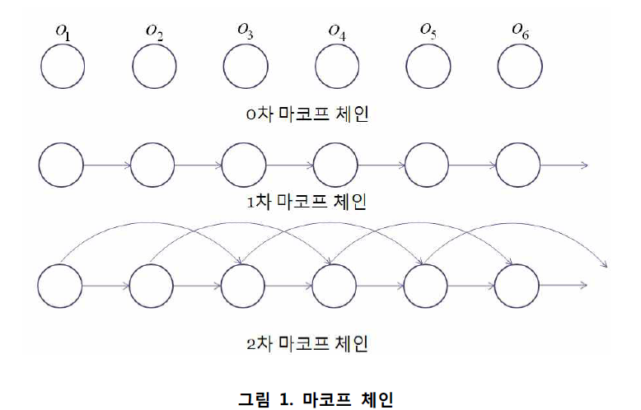
1. Markov Model
http://visbic.cse.pusan.ac.kr/~dhlee/wiki/images/f/fe/TR_%EA%B9%80%ED%83%9C%ED%98%95.pdf

Slide 3
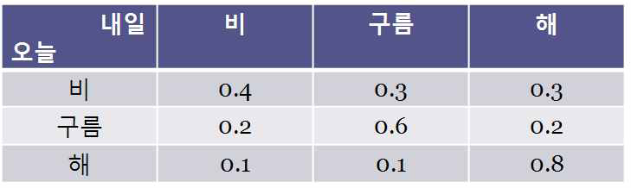
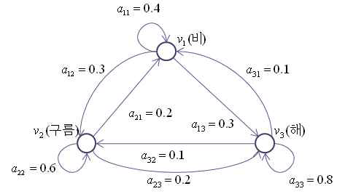
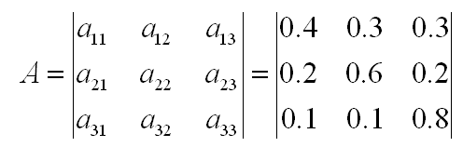
1. Markov Model
P(o = 비|o = 비, o = 비, o = 비)
P(o = 비|o = 비, o = 비, o = 해)
P(o = 비|o = 비, o = 해, o = 비)
P(o = 비|o = 비, o = 해, o = 해)

Slide 4
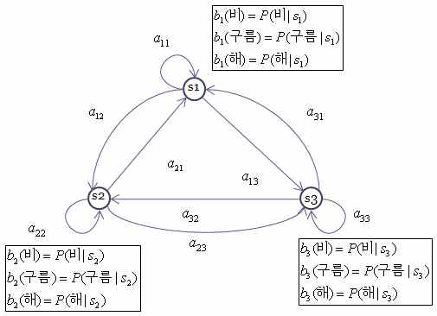
2. Hidden Markov Model
= S

Slide 5
2. Hidden Markov Model
Ergodic model
  Every a_{ij} is positive.
  Every transition is possible.
Left-to-right (Bakis) model
  a_{ij} = 0, j<i
  Cannot go backward
  Good to model temporal structure of speech signals
isoft.postech.ac.kr/Course/CS730b/2005/speech_lecture2.ppt

Slide 6
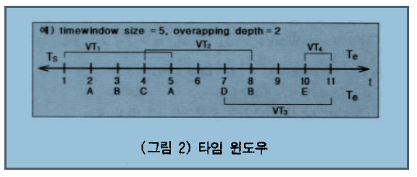
3. Data Mining
http://www.aistudy.co.kr/paper/pdf/transaction_kim.pdf

Slide 7
4 .SARIMA-Modelling
Seasonal Autoregressive Integrated Moving Average Processes
1. SARIMA – Differencing
2. SARIMA – Autoregressive Terms
3. SARIMA – Moving Average Terms
4. SARIMA – Seasonal Terms

Slide 8
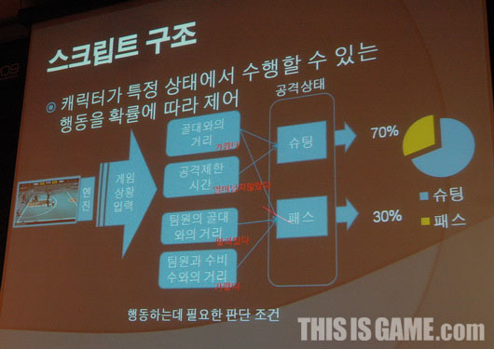
5. Neural Network

Slide 9
5. Neural Network

Slide 10
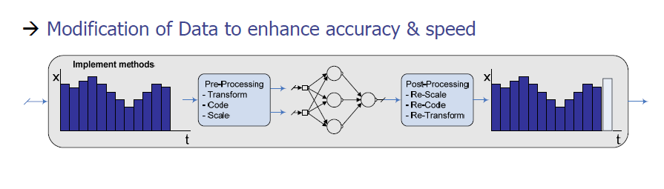
5. Neural Network
입력파라미터 정규화
A 적과의거리 => 0 ~ 1
B 전진 => 0,1
C 후진 => 0,1
D 점프 => 0,1
입력 파라미터 줄이기
B 전진 => 00
C 후진 => 01
D 점프 => 11

Slide 11
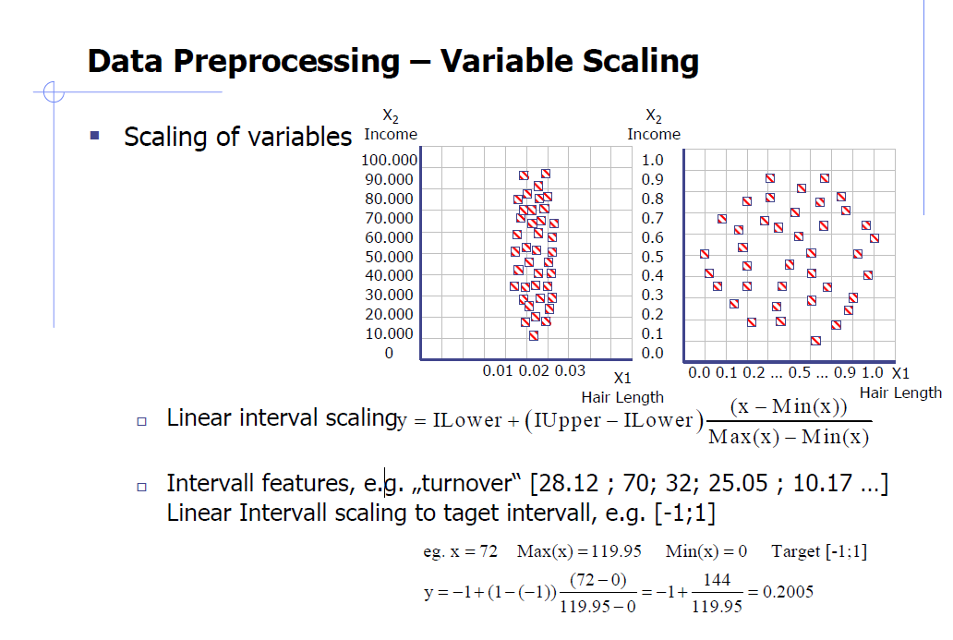
5. Neural Network

Slide 12
입력파라미터 정규화
A 적과의거리 => 0 ~ 1
B 전진 => 0,1
C 후진 => 0,1
D 점프 => 0,1
입력 파라미터 줄이기
B 전진 => 00
C 후진 => 01
D 점프 => 11

